Slide 1

STOCK MARKET PREDICTION USING AI AND ML
ANNAPAREDDY NAVEEN REDDY-(111720102008)
BAKIREDDY PRANEETH REDDY-(111720102015)
CHINTHAM SREE SASANK REDDY-(111720102029)
DEVINENI KAUSHIK CHARAN-(111720102032)

Slide 2


WHAT IS STOCK MARKET?
The financial market is a dynamic and composite system where people can buy and sell currencies, stocks, equities and derivatives over virtual platforms supported by brokers. The stock market allows investors to own shares of public companies through trading either by exchange or over the counter markets..
A REFERENCE VIDEO FOR UNDERSTANDING WHAT ARE STOCKS:
https://youtu.be/ZCFkWDdmXG8

Slide 3

ABSTRACT
Stock price prediction is the most signific ally used in the financial sector . Stock market is volatile in nature ,so it is difficult to predict stock prices.
This is a time series problem . stock price prediction is a difficult task where there no rules to predict the price of the stock in the stock market.

Slide 4
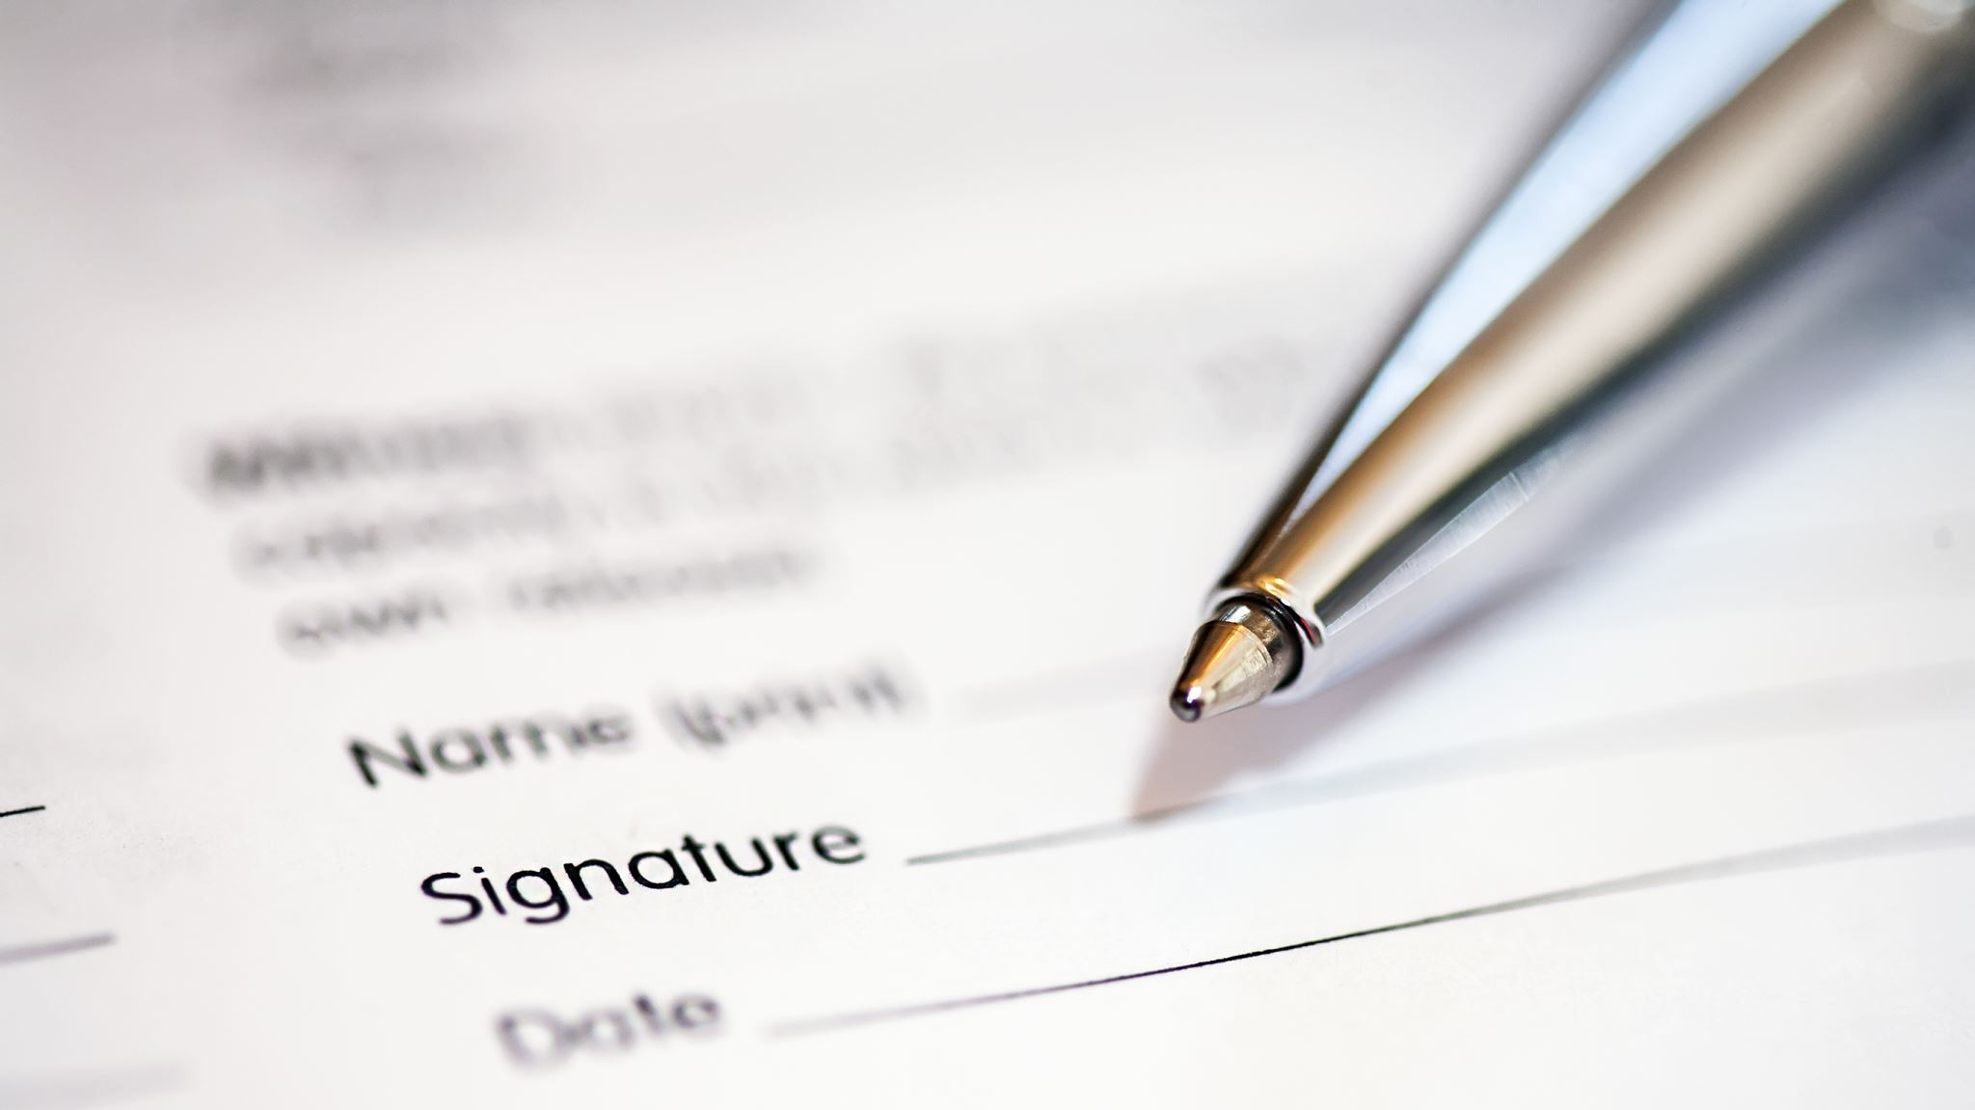
Problem statement
Time Series forecasting & modelling plays an important role in data analysis.
Time series analysis is a specialized branch of statistics used extensively in fields such as Econometrics & Operation Research.
The Opening Value of the stock, the Highest and Lowest values of that stock on the same days, as well as the Closing Value at the end of the day, are all indicated for each date.
The Adjusted Close Value reflects the stock’s value after dividends have been declared (too technical!).

Slide 5
Existing Methods
Stock Price Correlation Coefficient Prediction with ARIMA-LSTM Hybrid Model
stock market prediction using artificial neural networks on tick data
Proposed Methods
Long short-term memory network

Slide 6

Technologies Used:
LSTM(Long Short-Term Memory Algorithm)
Artificial Intelligence
Linear Regression in Statistics

Slide 7

References:
https://www.iarchives/V6/i3/IRJET-V6I3219.pdf https://drive.google.com/file/d/17Pvf0yBfcVmQ6n5ZGoBWv_i9x1JSd3ZC/view?usp=sharingrjet.net/

Slide 8
PROJECT REPORT
https://docs.google.com/document/d/1YTRQwAQHeTlTiN3oqhFT4QWOWMopfcOl/edit?usp=sharing&ouid=105096113977720625974&rtpof=true&sd=true

Slide 9

THANKYOU!!!

